Slide 1
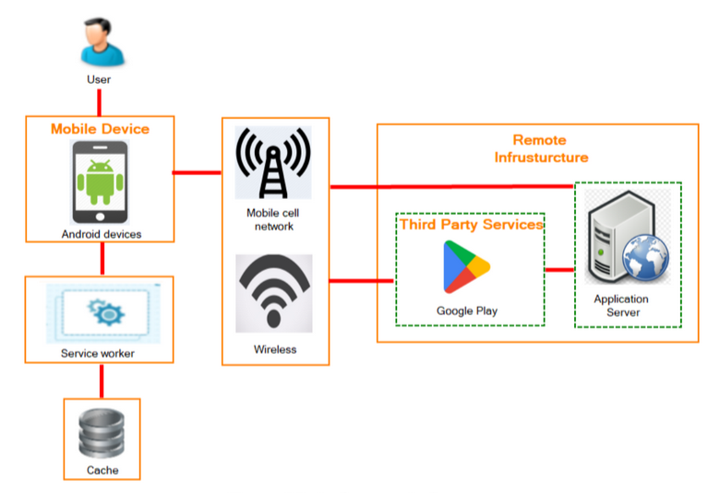

Slide 2

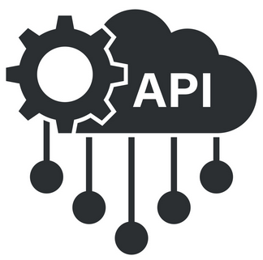





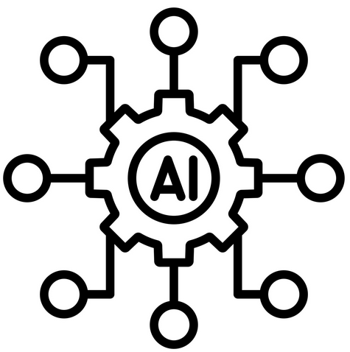

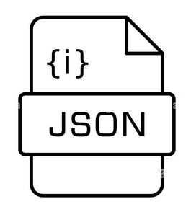
Remote Infrastructure
(Hosted on Lightning.AI)
Remote AI server
User
Network Connectivity
Mobile Device
Cellular Network
FastAPI/LitServe Endpoint
Third Party Services
Android devices
Wireless Network
iNaturalist API
Pytorch Transformer Model
Local Data Management
(Hosted on Lightning.ai)
Structured
Static information

Slide 3

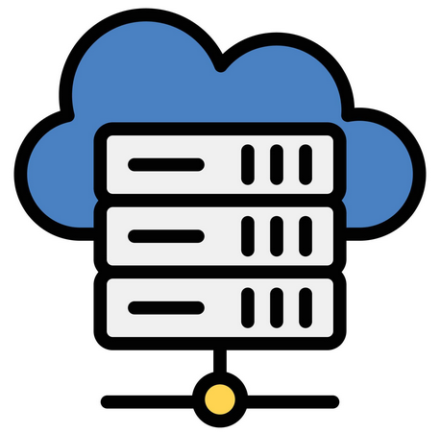

User
Internet access
(Hosted on Lightning.AI)
Internet access
Service worker

